Slide 1

Verifying Cyber-Physical Systems
Chapter 9 – Reachability Analysis
Abenezer Taye
Feb 6, 2023

Slide 2
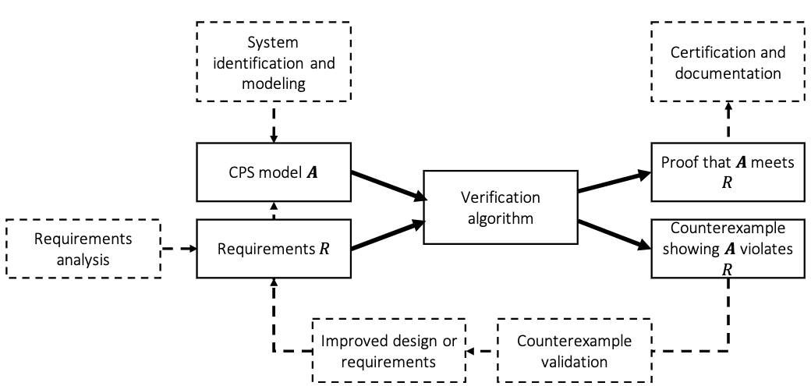
System Design Ecosystem

Slide 3
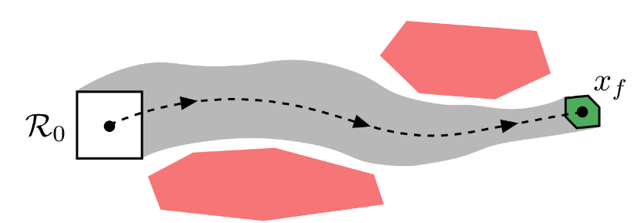
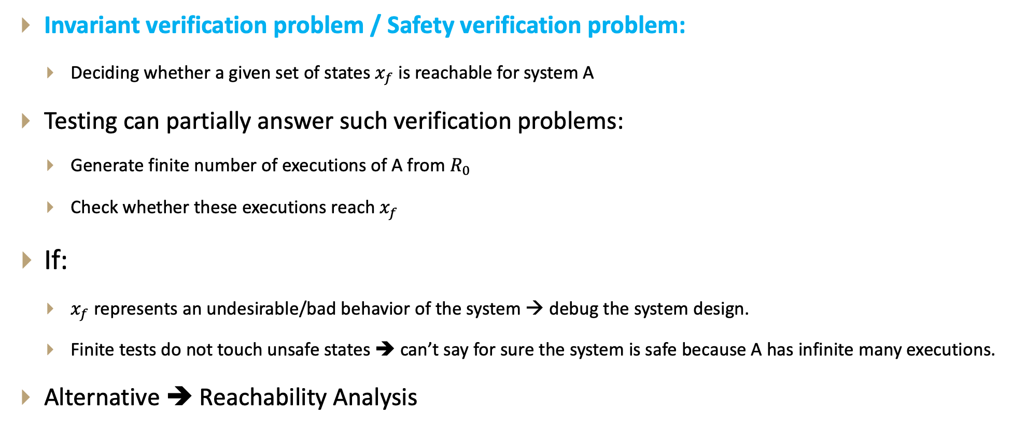
Introduction
Invariant verification problem / Safety verification problem:
Deciding whether a given set of states $x_{f}$ is reachable for system A
Testing can partially answer such verification problems:
Generate finite number of executions of A from $R_{0}$
Check whether these executions reach $x_{f}$
If:
$x_{f}$ represents an undesirable/bad behavior of the system → debug the system design.
Finite tests do not touch unsafe states ➔ can’t say for sure the system is safe because A has infinite many executions.
Alternative ➔ Reachability Analysis

Slide 4
Introduction
Typical problem in reachability analysis → State Space Explosion
Dimension of the system
Time horizon
Degree of uncertainty in the model
Focus on specific classes of Hybrid Automata for which safety properties (invariants) can be verified completely automatically
Timed Automata
Rational time automata
Multi-rate automata
Rectangular Initialized HA
Rectangular HA
Linear HA
Nonlinear HA

Slide 5
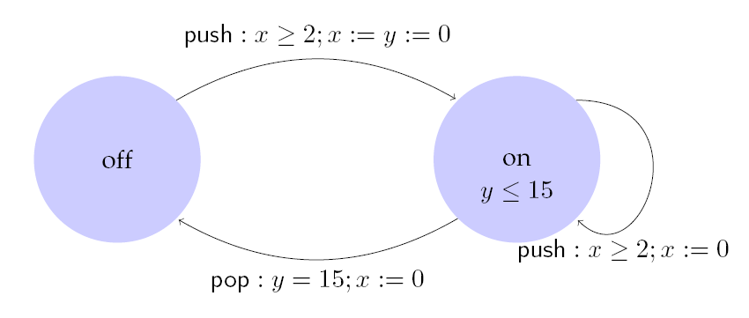
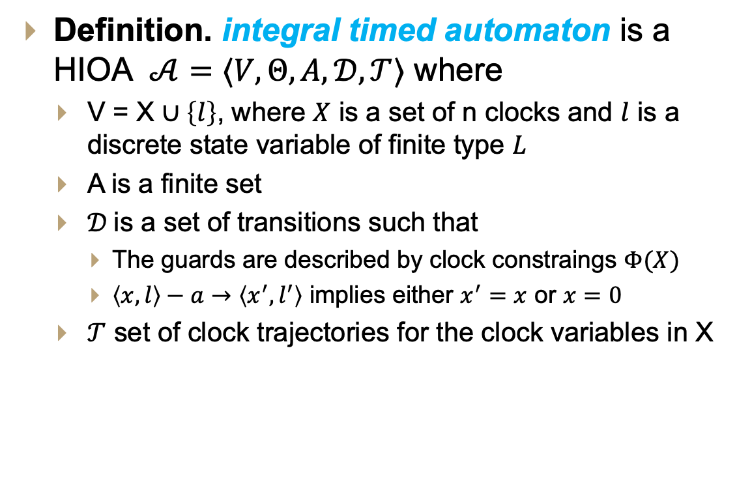
Example: Light Switch
Integral Timed Automata
Definition. integral timed automaton is a HIOA $𝒜=〈V, Θ, A, 𝒟, 𝒯〉$ where
V = X $∪\left\{l\right\}$, where $X$ is a set of n clocks and $l$ is a discrete state variable of finite type $L$
A is a finite set
$𝒟$is a set of transitions such that
The guards are described by clock constraings $Φ(X)$
$〈x,l〉−a→〈x^{′},l^{′}〉$ implies either $x^{′}=x$ or $x=0$
$𝒯$ set of clock trajectories for the clock variables in X
Description
Switch can be turned on whenever at least 2 time units have elapsed since the last turn on. Switches off automatically 15 time units after the last on.

Slide 6
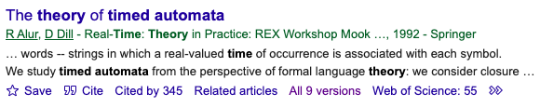
Control State Reachability Problem
Given an ITA 𝒜, check if a particular (discrete) control state is reachable from the initial states
This problem is decidable [Alur Dill]
Key idea:
Construct a finite automaton B that is a time-abstract bisimilar to the ITA B(behaves identically with respect to control state reachability)
That is, Finite Automaton B behaves identically to ITA A w.r.t. control state reachability, but does not preserve timing information.
Check reachability of FSM B using graph search techniques

Slide 7
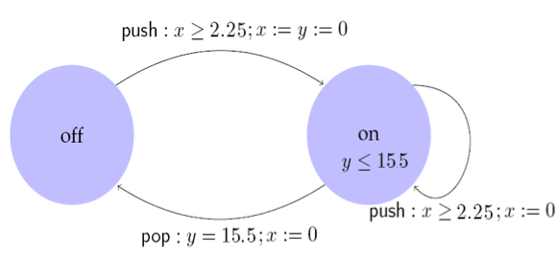
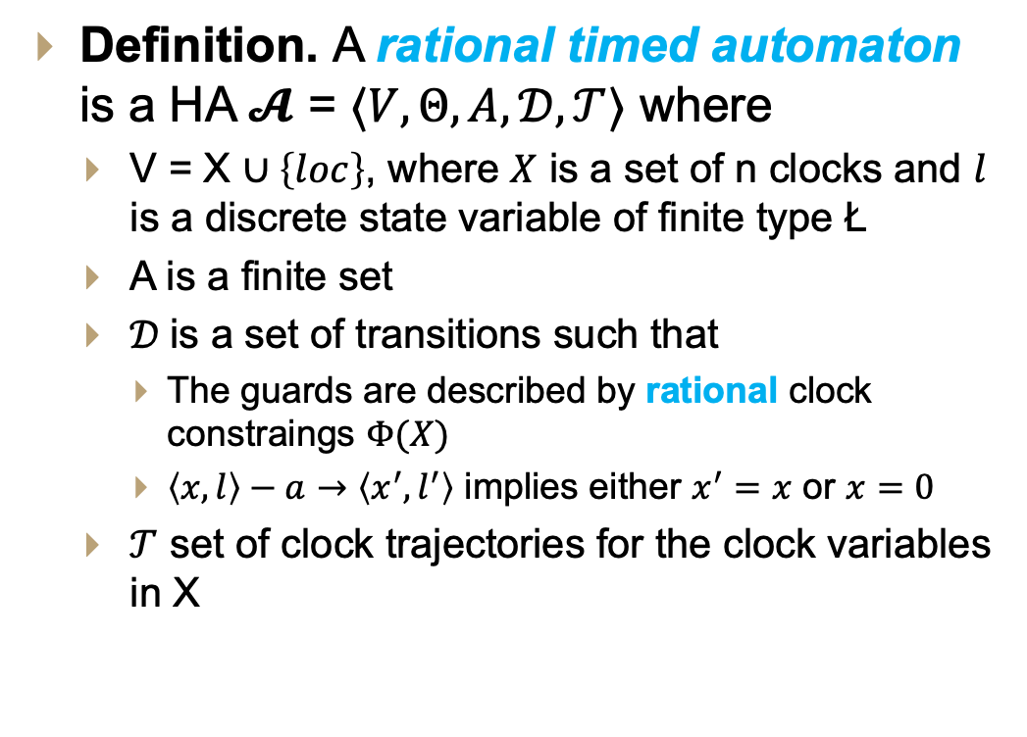
Example: Light Switch
Rational Timed Automata
Definition. A rational timed automaton is a HA $𝓐$ = $〈V, Θ, A, 𝒟, 𝒯〉$ where
V = X $∪\left\{loc\right\}$, where $X$ is a set of n clocks and $l$ is a discrete state variable of finite type Ł
A is a finite set
$𝒟$is a set of transitions such that
The guards are described by rational clock constraings $Φ(X)$
$〈x,l〉−a→〈x^{′},l^{′}〉$ implies either $x^{′}=x$ or $x=0$
$𝒯$ set of clock trajectories for the clock variables in X
Description
Switch can be turned on whenever at least 2.25 time units have elapsed since the last turn off or on. Switches off automatically 15.5 time units after the last on.

Slide 8
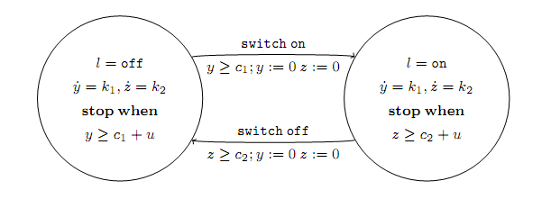
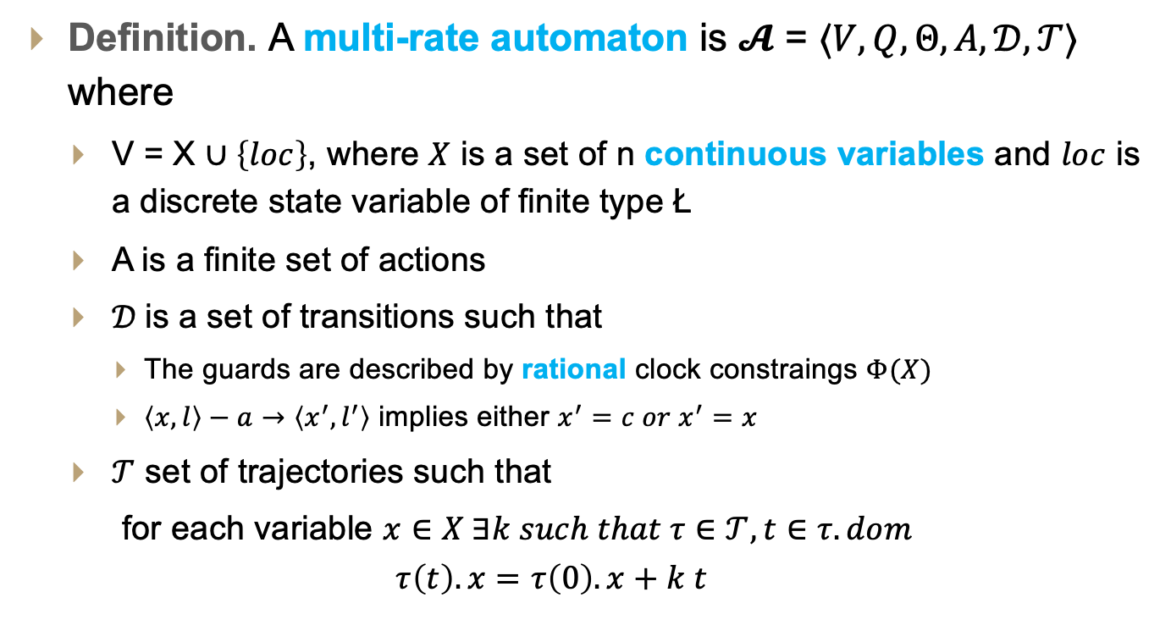
Multi-Rate Automaton
Definition. A multi-rate automaton is $𝓐$ = $〈V, Q, Θ, A, 𝒟, 𝒯〉$ where
V = X $∪\left\{loc\right\}$, where $X$ is a set of n continuous variables and $loc$ is a discrete state variable of finite type Ł
A is a finite set of actions
$𝒟$is a set of transitions such that
The guards are described by rational clock constraings $Φ(X)$
$〈x,l〉−a→〈x^{′},l^{′}〉$ implies either $x^{′}=c{ or x}^{′}=x$
$𝒯$ set of trajectories such that
for each variable $x∈X ∃k such that τ∈𝒯, t∈τ.dom$
$$τ\left(t\right).x=τ\left(0\right).x+k t$$

Slide 9
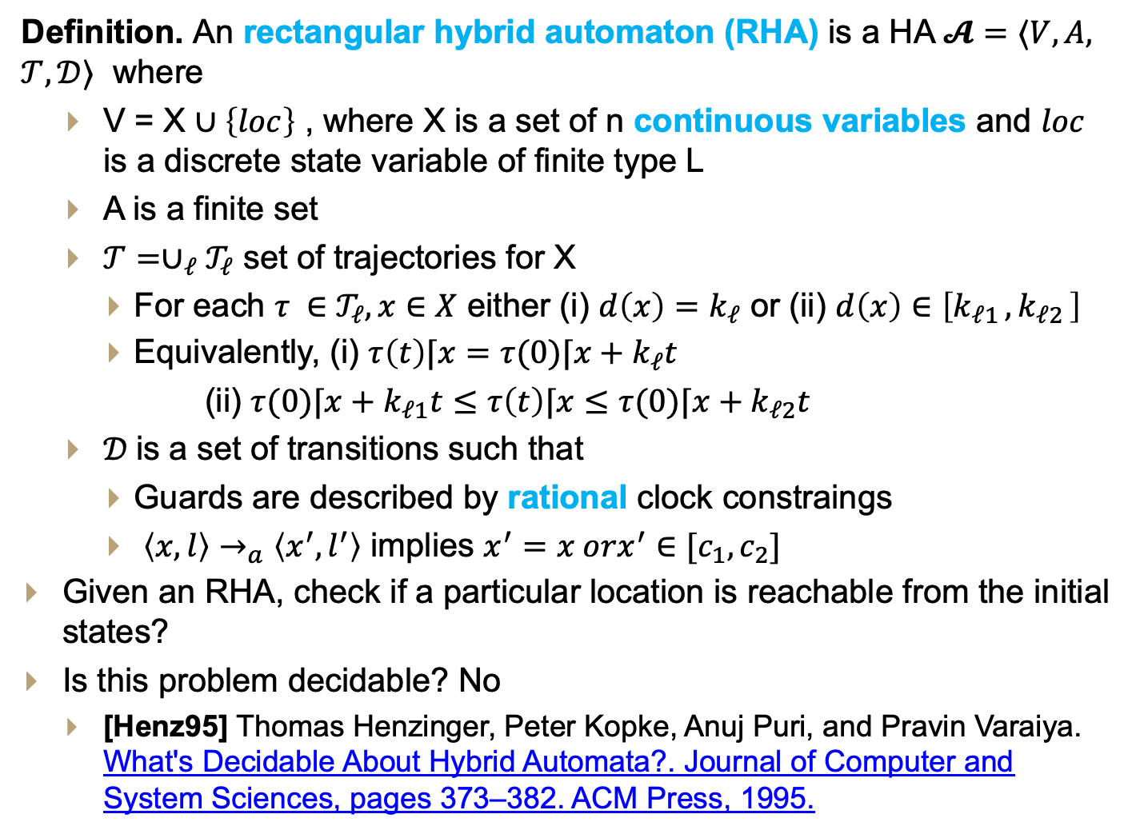
Rectangular HA
Definition. An rectangular hybrid automaton (RHA) is a HA $𝓐=⟨V,A,$ $𝒯,𝒟⟩$ where
V = X $∪\left\{loc\right\}$ , where X is a set of n continuous variables and $loc$ is a discrete state variable of finite type L
A is a finite set
$𝒯={∪_{ℓ}𝒯}_{ℓ}$ set of trajectories for X
For each $τ ∈𝒯_{ℓ}, x∈X$ either (i) $d\left(x\right)=k_{ℓ}$ or (ii) $d\left(x\right)∈\left[k_{ℓ1 },k_{ℓ2 }\right]$
Equivalently, (i) $τ\left(t\right)⌈x=τ(0)⌈x+k_{ℓ}t$
(ii) $τ(0)⌈x+k_{ℓ1}t≤τ\left(t\right)⌈x≤$ $τ(0)⌈x+k_{ℓ2}t$
$𝒟$is a set of transitions such that
Guards are described by rational clock constraings
$〈x,l〉→_{a}〈x^{′},l^{′}〉$ implies $x^{′}=x orx^{′}∈[c_{1},c_{2}]$
Given an RHA, check if a particular location is reachable from the initial states?
Is this problem decidable? No
[Henz95] Thomas Henzinger, Peter Kopke, Anuj Puri, and Pravin Varaiya. What's Decidable About Hybrid Automata?. Journal of Computer and System Sciences, pages 373–382. ACM Press, 1995.
Generalizes multi-rate automata by allowing nondeterministic trajectories and resets.

Slide 10
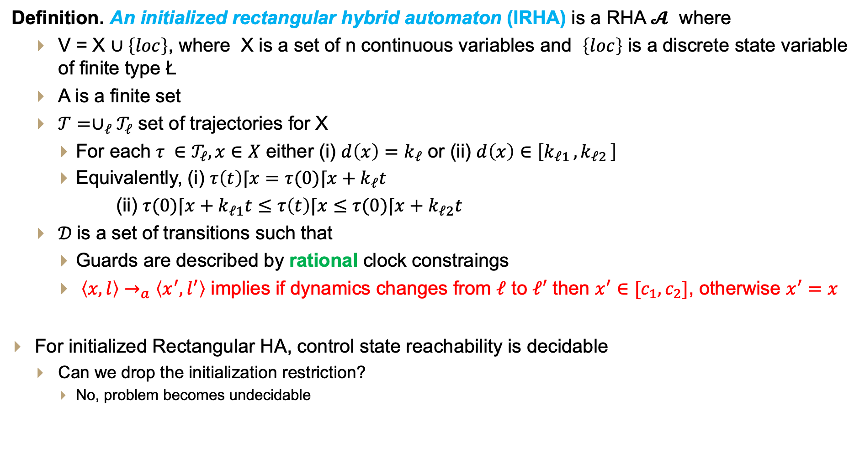
Initialized Rectangular HA
Definition. An initialized rectangular hybrid automaton (IRHA) is a RHA $𝓐$ where
V = X $∪\left\{loc\right\}$, where X is a set of n continuous variables and $\left\{loc\right\}$ is a discrete state variable of finite type Ł
A is a finite set
$𝒯={∪_{ℓ}𝒯}_{ℓ}$ set of trajectories for X
For each $τ ∈𝒯_{ℓ}, x∈X$ either (i) $d\left(x\right)=k_{ℓ}$ or (ii) $d\left(x\right)∈\left[k_{ℓ1 },k_{ℓ2 }\right]$
Equivalently, (i) $τ\left(t\right)⌈x=τ(0)⌈x+k_{ℓ}t$
(ii) $τ(0)⌈x+k_{ℓ1}t≤τ\left(t\right)⌈x≤$ $τ(0)⌈x+k_{ℓ2}t$
$𝒟$is a set of transitions such that
Guards are described by rational clock constraings
$〈x,l〉→_{a}〈x^{′},l^{′}〉$ implies if dynamics changes from $ℓ$ to $ℓ′$ then $x^{′}∈[c_{1},c_{2}]$, otherwise $x^{′}=x$
For initialized Rectangular HA, control state reachability is decidable
Can we drop the initialization restriction?
No, problem becomes undecidable
The continuous variables are forced to be initialized every time their dynamics changes

Slide 11
Data Structures for Reachability Analysis

Slide 12
Common Data Structures for RA
Hyperrectangles
Polyhedra [Halbwachs et al. 1994]
Zonotopes [Girard 2005]
Ellipsoids [Kurzhanskiy 2001]
Support functions [Guernic et al. 2009]
Generalized star set [Duggirala and Viswanathan 2018]

Slide 13
Hyper-rectangles
A hyperrectangle is the n-dimensional generalization of an interval [a,b].

Slide 14
Polytopes
Generalize hyperrectangles by representing sets as intersections of arbitrary –not necessarily orthogonal – half-spaces.

Slide 15
Zonotopes
A zonotope is specified by a center, and a collection of generator vectors.
Each vector defines a line segment centered at the center.

Slide 16

Ellipsoids
Ellipsoids generalize spheres in $R^{n}.$
It is defined by a center $c∈R^{n}$ and a shape matric $Q∈R^{nxn}$

Slide 17
Thank You!!!
Q&A

